Slide 1
Pipeline and vector processing
UNIT-2 2nd part

Slide 2
Pipelining
Pipelining is a technique of decomposing a sequential process into subprocess, with each subprocess being executed in a special dedicated segment that operates concurrently with all other segments
Each segment performs partial processing dictated by the way the task is partitioned
The result obtained from the computation in each segment is transferred to the next segment in the pipeline
The final result is obtained after the data have passed through all segments, Can imagine that each segment consists of an input register followed by an combinational circuit
A clock is applied to all registers after enough time has elapsed to perform all segment activity

Slide 3
Example of Pipelining.
Ai Bi Ci
R1 Ai , R2 Bi
Input Ai and Bi
R3 R1 * R2, R4 Ci
Multiply and input Ci
R5 R3 + R4
Add Ci to product
R1
R2
Multiplier
R3
R4
Adder
R5

Slide 4
Content of registers in pipeline example.
Clock Pulse number
Segment1 R1 R2
Segment2 R3 R4
Segment3 R5
1 A1 B1 ---- ---- ---- 2 A2 B2 A1*B1 C1 ---- 3 A3 B3 A2*B2 C2 A1*B1+C1 4 A4 B4 A3*B3 C3 A2*B2+C2 5 A5 B5 A4*B4 C4 A3*B3+C3 6 A6 B6 A5*B5 C5 A4*B4+C4 7 A7 B7 A6*B6 C6 A5*B5+C5 8 ---- ---- A7*B7 C7 A6*B6+C6 9 ---- ---- ---- ---- A7*B7+C7

Slide 5
GENERAL PIPELINE
General Structure of a 4-Segment Pipeline
Clock
Input
S
R
S
R
S
R
S
R
1
1
2
2
3
3
4
4
Space-Time Diagram
1
2
3
4
5
6
7
8
9
Clock cycles
Segment
1
T1
T2
T3
T4
T5
T6
2
T1
T2
T3
T4
T5
T6
3
T1
T2
T3
T4
T5
T6
4
T1
T2
T3
T4
T5
T6

Slide 6
PIPELINE SPEEDUP
n: Number of tasks to be performed
Conventional Machine (Non-Pipelined)
t_{n}: Clock cycle
τ₁: Time required to complete the n tasks
τ₁ = n * t_{n}
Pipelined Machine (k stages)
t_{p}: Clock cycle (time to complete each suboperation)
τ_{κ}: Time required to complete the n tasks
τ_{κ} = (k + n - 1) * t_{p}
Speedup
S_{k}: Speedup
S_{k} = n*t_{n} / (k + n - 1)*t_{p}
t_{n}
lim
S_{k} =
t_{p}
( = k, if t_{n} = k * t_{p} )
n → ∞

Slide 7
PIPELINE AND MULTIPLE FUNCTION UNITS
Example:
- 4-stage pipeline
- subopertion in each stage; t_{p} = 20nS
- 100 tasks to be executed
- 1 task in non-pipelined system; 20*4 = 80nS
Pipelined System
(k + n - 1)*t_{p} = (4 + 99) * 20 = 2060nS
Non-Pipelined System
n*k*t_{p} = 100 * 80 = 8000nS
Speedup
S_{k} = 8000 / 2060 = 3.88
4-Stage Pipeline is basically identical to the system
with 4 identical function units

Slide 8
ARITHMETIC PIPELINE
Pipeline arithmetic units are usually found in very high speed computers
They are used to implement floating-point operations, multiplication of fixed-point numbers, and similar computations encountered in scientific problems
Example for floating-point addition and subtraction
Inputs are two normalized floating-point binary numbers X = A x 2ª
Y = B x 2^{b}
A and B are two fractions that represent the mantissas
a and b are the exponents
Four segments are used to perform the following:
Compare the exponents
Align the mantissas
Add or subtract the mantissas
Normalize the result

Slide 9
ARITHMETIC PIPELINE
Floating-point adder
Exponents
Mantissas
a
b
A
B
X = A x 2ª
Y = B x 2^{b}
R
R
[1] Compare the exponents
[2] Align the mantissa
[3] Add/sub the mantissa
[4] Normalize the result
Segment 1:
Compare
Difference
exponents
by subtraction
R
Segment 2:
Choose exponent
Align mantissa
R
Segment 3:
Add or subtract
mantissas
R
R
Segment 4:
Adjust
Normalize
exponent
result
R
R

Slide 10
Example
X = 0.9504 x 10³ and Y = 0.8200 x 10²
The two exponents are subtracted in the first segment to obtain 3-2=1
The larger exponent 3 is chosen as the exponent of the result
Segment 2 shifts the mantissa of Y to the right to obtain Y = 0.0820 x 10³
The mantissas are now aligned
Segment 3 produces the sum Z = 1.0324 x 10³
Segment 4 normalizes the result by shifting the mantissa once to the right and incrementing the exponent by one to obtain Z = 0.10324 x 10⁴

Slide 11
Instruction Pipeline
An instruction pipeline reads consecutive instructions from memory while previous instructions are being executed in other segments
This causes the instruction fetch and execute phases to overlap and perform simultaneous operations
If a branch out of sequence occurs, the pipeline must be emptied and all the instructions that have been read from memory after the branch instruction must be discarded.
In the most General cases the computer needs to process each instruction with the following sequence of steps:
Fetch the instruction from memory.
Decode the instruction.
Calculate the effective address.
Fetch the operands from memory.
Execute the instruction.
Store the result in the proper place.

Slide 12
Figure 9-7 Four-segment CPU pipeline.
Fetch instruction
from memory
Segment 1
Decode instruction
And calculate
Effective address
Segment 2
yes
Branch?
no
Segment 3
Fetch operand
From memory
Segment 4
Execute instruction
Interrupt
handling
yes
Interrupt?
no
Update PC
Empty pipe

Slide 13
Segments and their purpose.
FI is the segment that fetches an instruction. DA is the segment that decodes the instruction and calculate the effective address. FO is the segment that fetches the operand. EX is the segment that executes the instruction.

Slide 14
Timing of instruction pipeline.
Step:
1
2
3
4
5
6
7
8
9
10
11
12
13
Instruction:
1
FI
DA
FO
EX
2
FI
DA
FO
EX
(Branch)
3
FI
DA
FO
EX
4
FI -- --
EX
FI
DA
FO
5
--
--
--
FI
DA
FO
EX
6
FI
DA
FO
EX
7
FI
DA
FO
EX

Slide 15
Pipeline Conflicts
Reasons for the pipeline to deviate from its normal operation are:
Resource conflicts caused by access to memory by two segments at the same time.
Data dependency conflicts arise when an instruction depends on the result of a previous instruction, but his result is not yet available
Branch difficulties arise from program control instructions that may change the value of PC

Slide 16
Methods to handle data dependency:
o Hardware interlocks are circuits that detect instructions whose source operands are destinations of prior instructions. Detection causes the hardware to insert the required delays without altering the program sequence.
o Operand forwarding uses special hardware to detect a conflict and then avoid it by routing the data through special paths between pipeline segments. This requires additional hardware paths through multiplexers as well as the circuit to detect the conflict.
o Delayed load is a procedure that gives the responsibility for solving data conflicts to the compiler. The compiler is designed to detect a data conflict and reorder the instructions as necessary to delay the loading of the conflicting data by inserting no-operation instructions.

Slide 17
Methods to handle branch instructions:
o Prefetching the target instruction in addition to the next instruction allows either instruction to be available.
o A branch target buffer is an associative memory included in the fetch segment of the branch instruction that stores the target instruction for a previously executed branch.
It also stores the next few instructions after the branch target instruction. This way, the branch instructions that have occurred previously are readily available in the pipeline without interruption.
o The loop buffer is a variation of the BTB. It is a small very high speed register file maintained by the instruction fetch segment of the pipeline. Stores all branches within a loop segment.
o Branch prediction uses some additional logic to guess the outcome of a conditional branch instruction before it is executed. The pipeline then begins prefetching instructions from the predicted path.
o Delayed branch is used in most RISC processors so that the compiler rearranges the instructions to delay the branch.

Slide 18
Vector Operations
A vector is an ordered set of one dimensional array of data items.
A vector V of length n is represented as a row vector b Y V=[V1, V2, V3,…….Vn]
Ability to process vectors, and related data structures such as matrices and multi-dimensional arrays, much faster than conventional computers
Vector Processors may also be pipelined
To examine the difference between the conventional scalar processor and vector processor consider the following Fortran Do loop:
DO 20 I = 1, 100
20 C(I) = B(I) + A(I)
Conventional computer
Initialize I = 0
20 Read A(I)
Read B(I)
Store C(I) = A(I) + B(I)
Increment I = i + 1
If I ≤ 100 goto 20
Vector computer
C(1:100) = A(1:100) + B(1:100)

Slide 19
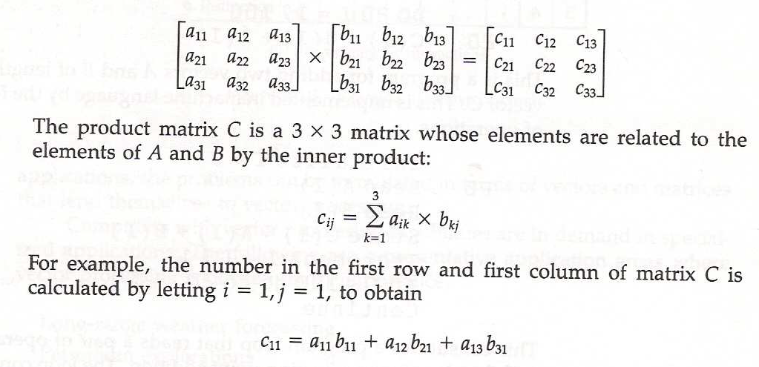
Matrix Multiplication
Matrix multiplication is one of the most computational intensive operations performed in computers with vector processors.

Slide 20
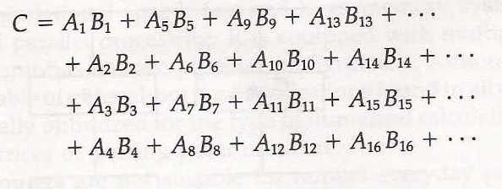
Pipeline for calculating an inner product
Source
A
Source
B
Multiplier
pipeline
Adder
pipeline

Slide 21
Application of Vector Processing
Long-range weather forecasting
Petroleum explorations
Seismic data analysis
Medical diagnosis
Aerodynamics and space flight simulations
Artificial intelligence and expert systems
Mapping the human genome
Image processing

Slide 22
MEMORY INTERLEAVING
Pipeline and vector processors often require simultaneous access to memory from two or more process.
An instruction pipeline may require the fetching of instruction and an operand at the same time from two different segments.
An arithmetic pipeline usually requires two or more operands to enter the pipeline at the same time.
Instead of using two memory buses for simultaneous access, the memory can be partitioned into a number of modules connected to a common memory address and data buses.
A memory module is a memory array together with its own address and data register.
Each memory array has its own address register AR and data register DR.

Slide 23
Figure 9-13 Multiple module memory organization
Address bus
AR
AR
AR
AR
Memory
array
Memory
array
Memory
array
Memory
array
DR
DR
DR
DR
Data bus

